Slide 1
Titanic: Machine Learning from Disaster
Center for Innovation through Visualization & Simulation
(CIVS)
Purdue University Northwest
Hammond, IN 46323
October 05, 2017
Where Ideas Become Reality

Slide 2
CONTENTS
Background
Objectives
Dataset
Methodology
Results

Slide 3

BACKGROUND
Titanic sinking
Notes:
The sinking of the RMS Titanic is one of the most infamous shipwrecks in history. On April 15, 1912, during her maiden voyage, the Titanic sank after colliding with an iceberg, killing 1502 out of 2224 passengers and crew. This sensational tragedy shocked the international community and led to better safety regulations for ships.
One of the reasons that the shipwreck led to such loss of life was that there were not enough lifeboats for the passengers and crew. Although there was some element of luck involved in surviving the sinking, some groups of people were more likely to survive than others, such as women, children, and the upper-class.

Slide 4
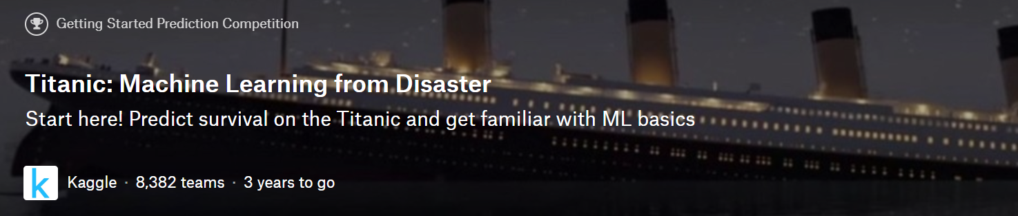
BACKGROUND
Kaggle
Platform for predictive modelling and analytics competitions
Huge amount of dataset
Ranking
Notes:
Analyze the dataset and solve the problem , then submit your results to Kaggle, Kaggle will give you score and ranking.

Slide 5
DATASET
The data has been split into two groups:
Training set (train.csv)
Testing set (test.csv)
Notes:
The training set should be used to build your machine learning models. For the training set, we provide the outcome for each passenger.
The test set should be used to see how well your model performs on unseen data

Slide 6
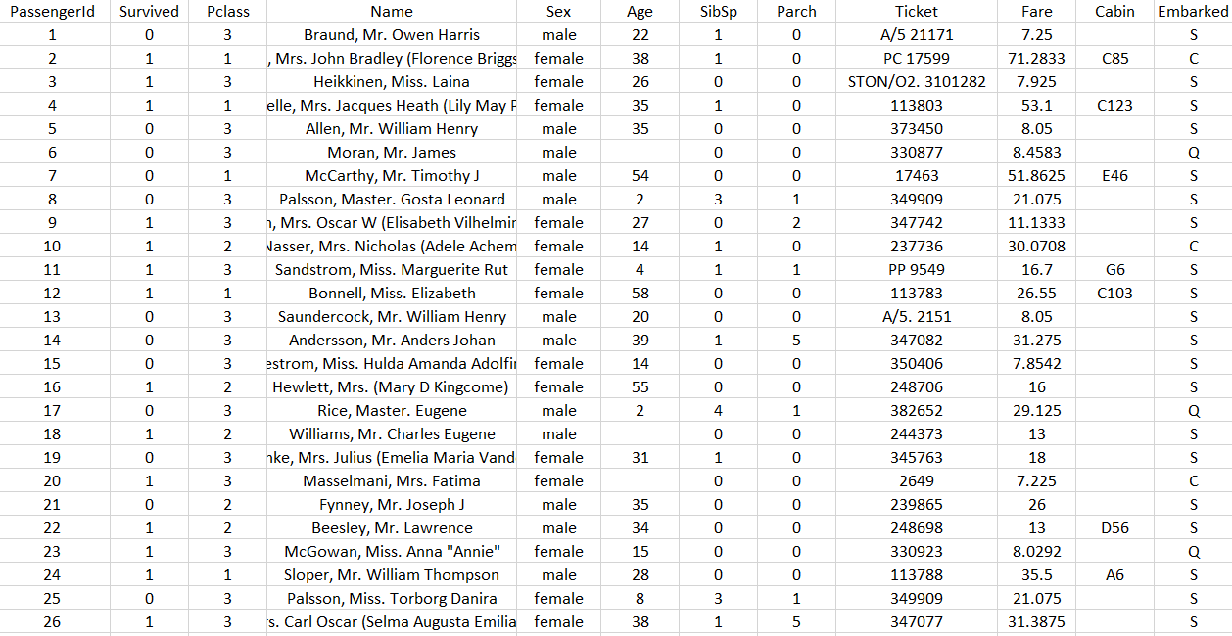
DATASET
Training data
Key
0 = No, 1 = Yes
1 = 1st, 2 = 2nd, 3 = 3rd
Variable | Definition
survival | Survival
pclass | Ticket class
sex | Sex
Age | Age in years
sibsp | # of siblings / spouses aboard the Titanic
parch | # of parents / children aboard the Titanic
ticket | Ticket number
fare | Passenger fare
cabin | Cabin number
embarked | Port of Embarkation
C = Cherbourg,
Q = Queenstown,
S = Southampton
Notes:
The training set should be used to build your machine learning models. For the training set, we provide the outcome for each passenger.
The test set should be used to see how well your model performs on unseen data

Slide 7
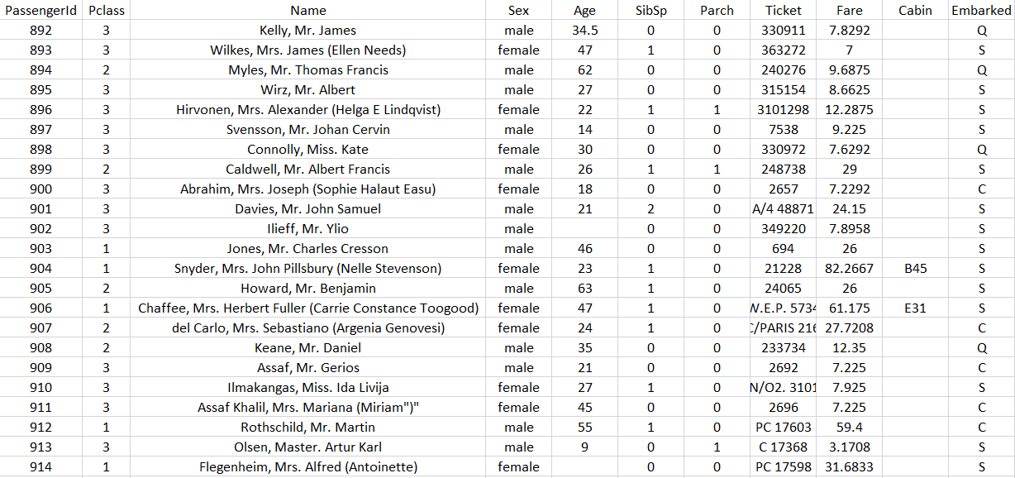
DATASET
Testing data
Notes:
The training set should be used to build your machine learning models. For the training set, we provide the outcome for each passenger.
The test set should be used to see how well your model performs on unseen data

Slide 8
OBJECTIVES
Predict if a passenger survived or not

Slide 9
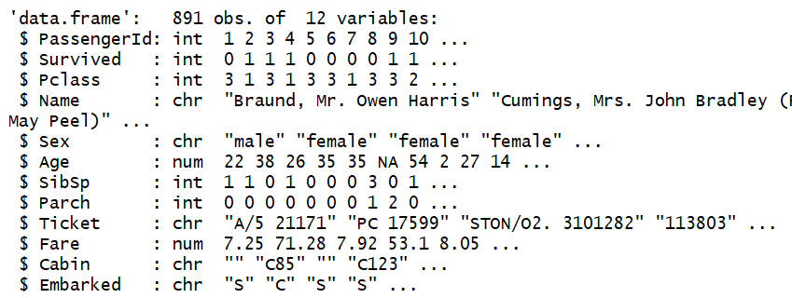
METHODOLOGY
Exploratory data analysis
compactly display the (abbreviated) contents of training data

Slide 10
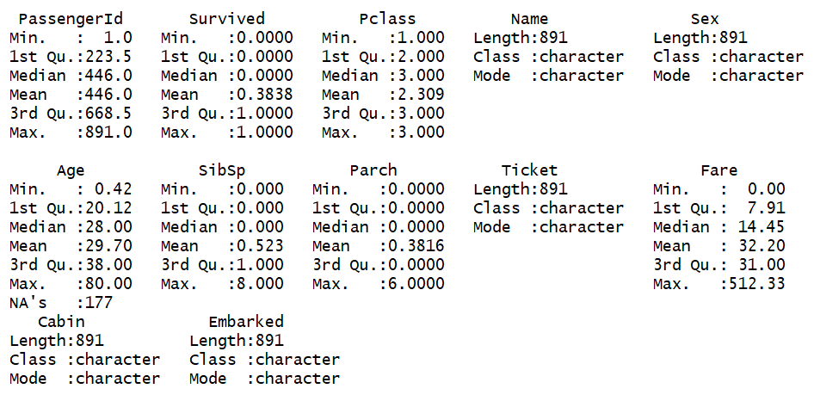
METHODOLOGY
Exploratory data analysis Statistical summary

Slide 11
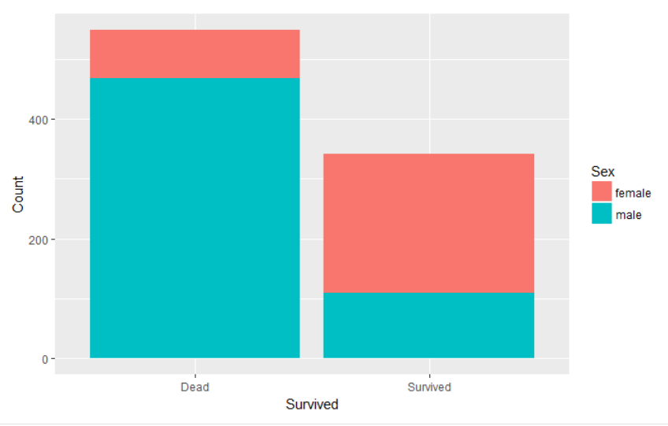
METHODOLOGY
Exploratory data analysis Women are more likely to survive.
Notes:
Let’s count how many passengers are survived among female and male

Slide 12
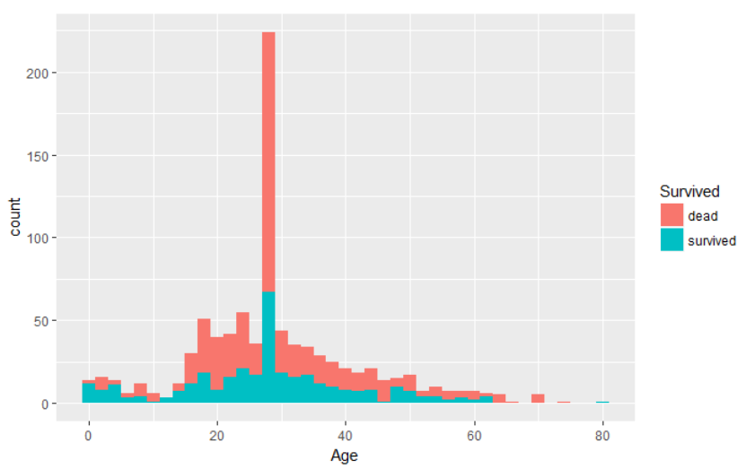
METHODOLOGY
Exploratory data analysis
passengers who are less than 10 are more likely to survive than older ones who are more than 12 and less than 50

Slide 13
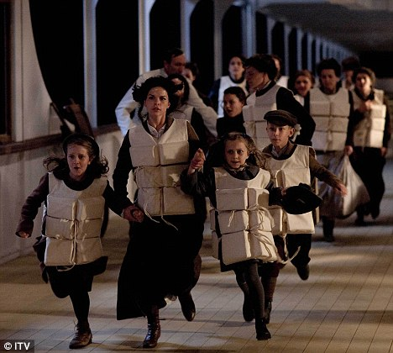
METHODOLOGY
Exploratory data analysis
Women and children first !

Slide 14
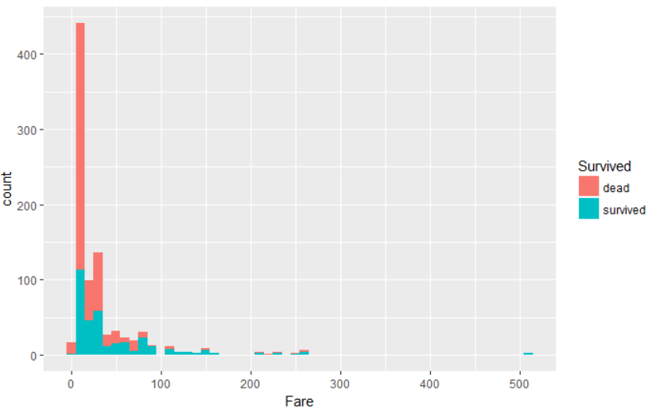
METHODOLOGY
Exploratory data analysis
Passengers with cheaper ticket fares are more likely to die.
Notes:
Remember to buy expensive ticket

Slide 15
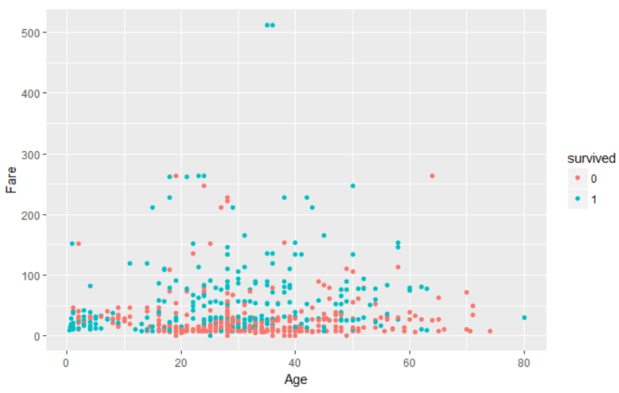
METHODOLOGY
Exploratory data analysis
Adults (age between 15 and 50) with lowest ticket fares are more likely to die.

Slide 16
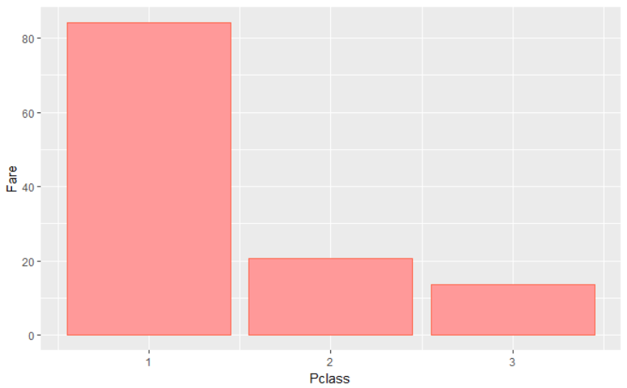
METHODOLOGY
Exploratory data analysis
Let’s see if higher Pclass has higher fare

Slide 17
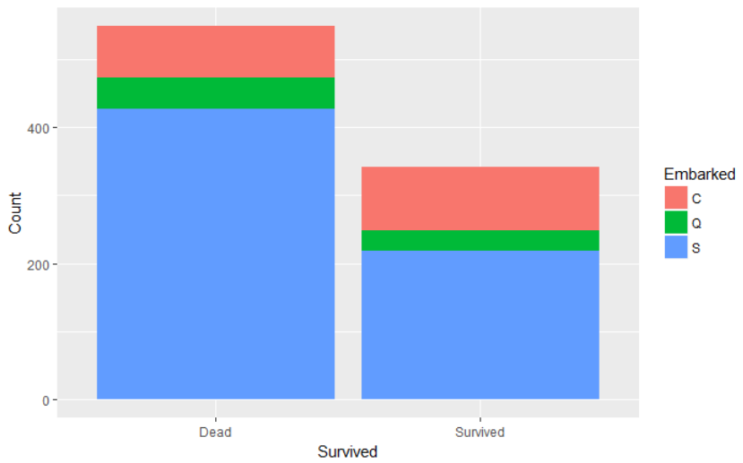
METHODOLOGY
Exploratory data analysis
Let’s see if embarkation site affects the survival
C = Cherbourg
Q = Queenstown
S = Southampton

Slide 18
METHODOLOGY
Feature engineering create new features according to the features we have.
Braund, Mr. Owen Harris
Heikkinen, Miss. Laina
Oliva y Ocana, Dona. Fermina
Peter, Master. Michael J
…
Officer
Royalty
Mr
Mrs
Miss
Master
Notes:
Extract title from names as a new feature

Slide 19
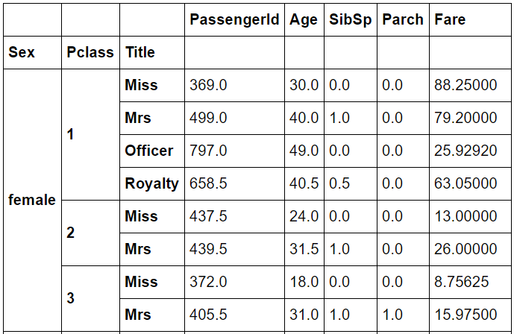
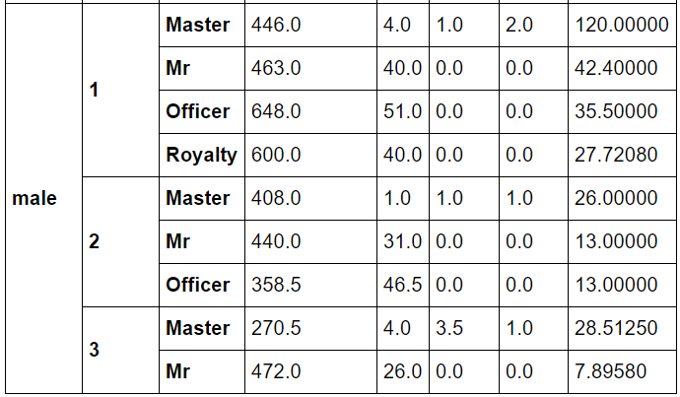
METHODOLOGY
Feature engineering Group the data base on Sex, Pclass, Title
Group
Calculate the Mean
Group
Calculate the Mean
Notes:
Extract title from names as a new feature

Slide 20
METHODOLOGY
Feature engineering
Decision tree
Sex
female
male
Pclass
Pclass
1
2
3
Title
Title
Title
…
Miss
Mrs
Officer
Royalty
…
30
40
49
40
Notes:
Extract title from names as a new feature

Slide 21


METHODOLOGY
Feature engineering
Use decision tree to fill missing ages
Sex
female
male
Pclass
Pclass
1
2
3
Title
Title
Title
…
Miss
Mrs
Officer
Royalty
…
30
40
49
40
Notes:
Extract title from names as a new feature

Slide 22
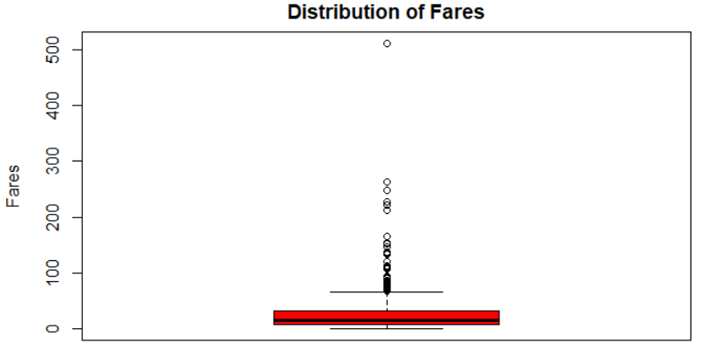
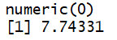
METHODOLOGY
Feature engineering
Use linear regression to fill missing Fare
Notes:
Extract title from names as a new feature

Slide 23
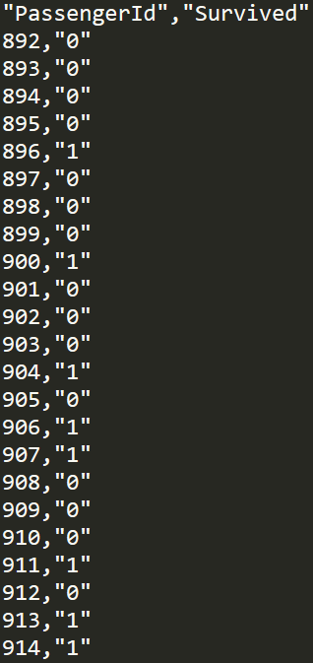
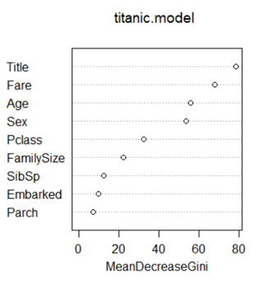
METHODOLOGY
Construct machine learning model
Use random forest to predict the survived column of testing data
Notes:
Extract title from names as a new feature

Slide 24

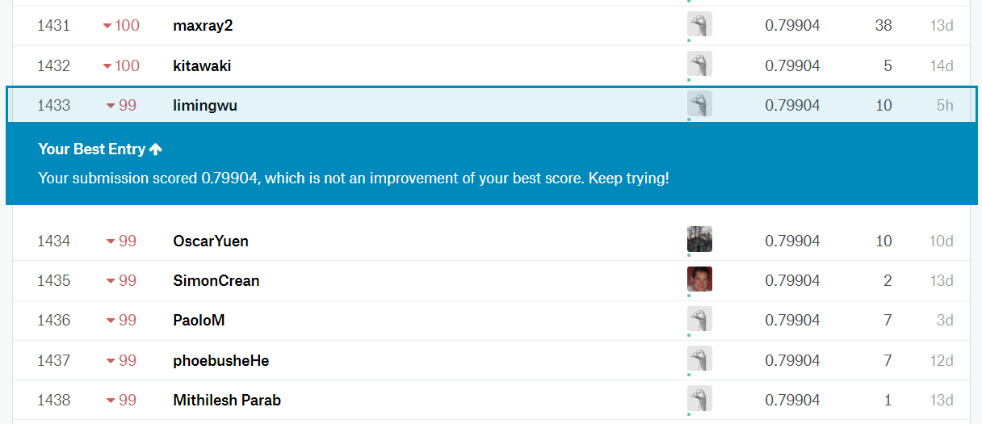
METHODOLOGY
Submit my results to Kaggle
Use random forest to predict the survived column of testing data
Notes:
Extract title from names as a new feature

Slide 25
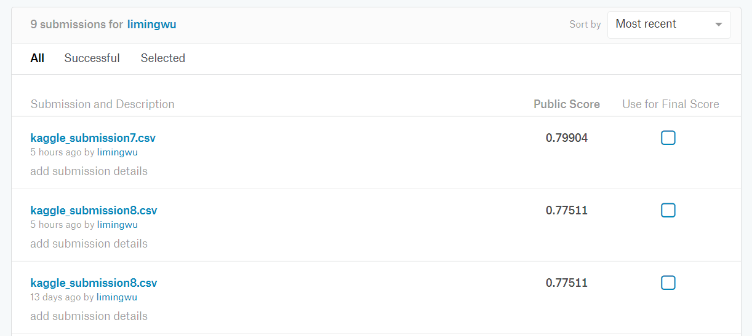
METHODOLOGY
Submit my results to Kaggle
Use random forest to predict the survived column of testing data
Notes:
Extract title from names as a new feature

Slide 26
CONCLUSION
Data exploration and visualization
Data cleaning
Feature engineering
Feature selection
Predictive model construction
Submission to Kaggle
Notes:
Extract title from names as a new feature

Slide 27
FUTURE WORK
In the next step, I will explore the features deeper and construct better features, and try different machine learning algorithms.
Notes:
Extract title from names as a new feature

Slide 28
Discussion & Q/A

